Slide 1



Parent and Carer Information Session
School Reopening
Tuesday 1st September 2020

Slide 2

Overview of session
PHE and Education Information
Transport
Resources
Advice
Partnerships
Bubbles
Context

Slide 3
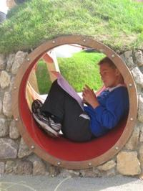
The anxious child
is not a learning child!

Slide 4

The PRINCIPLES that should guide all schools in their return are:
keep people safe and support each other across our schools
support students to learn over time and prepare for next steps
ensure support for our most vulnerable including those with health and medical needs
promote positive mental health and wellbeing amongst students and staff in settings
promote equity (people have what they need, rather than the same).

Slide 5
The current context in South Gloucestershire
Primary Schools returned on the 1st June and Secondary Schools returned on the 15th June, the South West had the highest return rates in the country
We had suspected cases in the second half of the Summer Term but all these were negative
The negative cases included both staff and pupils; where there have been no confirmed cases (All settings)
The rates of infection locally remain comparatively low

Slide 6
Local Authority preparations
We continue to monitor Public Health data both locally and regionally on a weekly basis and look for any trends
We have produced detailed guidance on reopening for our schools and have met with all our Heads: Primary, Secondary and Special
Webinars have taken place for CEOs, Heads, teachers, non-teaching staff, governors, wraparound providers and supply agencies on processes and key public health messages
There has been scenario planning with every sector: Early Years, Primary, Secondary and Post-16 during the summer
There are very clear systems in place for suspected, confirmed cases and outbreaks
We are supporting our schools in the context of children with mental health needs and are aware of those that may have suffered loss, trauma and many who have been shielding, we have created a range of resources/training to support schools
https://beta.southglos.gov.uk/returning-to-school-in-september/

Slide 7
National advice/guidance
General: ‘What parents and carers need to know about early years providers, schools and colleges in the autumn term’
Specific: Nurseries, childminders, schools and colleges will understand that some children and young people may be experiencing feelings such as anxiety, stress or low mood as a result of the coronavirus (COVID-19) outbreak.
There are online resources available to help you and your child with mental health, including:
MindEd, a free educational resource from Health Education England on children and young people’s mental health
Rise Above, which aims to build resilience and support good mental health in young people aged 10 to 16
Every Mind Matters, which includes an online tool and email journey to support everyone to feel more confident in taking action to look after their mental health and wellbeing
Bereavement UK and the Childhood Bereavement Network, provide information and resources to support bereaved pupils, schools and staff
It is also vital to report any safeguarding concerns you have about any child. Contact the NSPCC helpline or Barnardo’s support service.

Slide 8
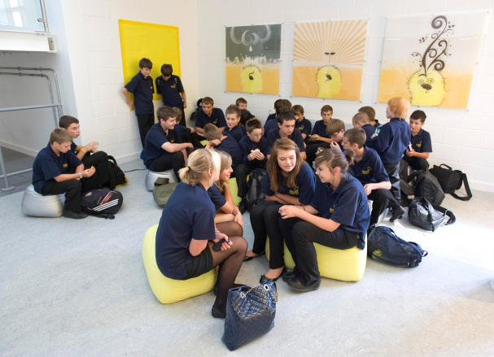
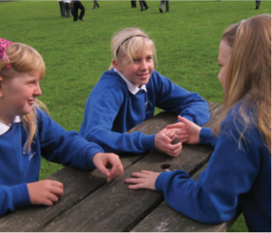
Key messages to our schools around being ready
Securely attached children are more likely to be:
better problem-solvers
more curious
have increased quality and duration of learning
have higher academic achievement
Securely attached children are more likely to be:
co-operative and self-regulative
less likely to develop emotional and behavioural problems
more socially empathetic and less biased in interpreting behaviour of others
more self-aware (self-knowledge)

Slide 9
#SOUTHGLOSCONNECT
1. Strategic oversight group
5. Stakeholder group (Parents/carers, governors/trustees, staff/Headteacher well being)
5
2. Stress, trauma,
loss and bereavement (SEMH) group
supported by specialist schools and settings, supported by specialist schools and settings
2
1
4. The reconnection to reparation, recovery to resilience curriculum.
(Rising strong curriculum,
Enduring strong curriculum,
Transitions)
4
3. Valuing the unique learner group (SEND, EAL, PP, GRT, more able, the tutored child)
3

Slide 10
School Transport
If you have dedicated transport – you should have been notified. Although the children on the transport route are treated as a bubble, in order to limit the possible spread of Covid-19 enhanced operating procedures will be in place on transport. For our Client Transport team the following measures will be adopted: -
how pupils are grouped together on transport, where possible this should reflect the bubbles that are adopted within school
additional cleaning of vehicles
organised queuing and boarding where possible
distancing within vehicles wherever possible
the use of face coverings for children over the age of 11, where appropriate, for example, if they are likely to come into very close contact with people outside of their group or who they do not normally meet
in addition, all staff operating transport will be required to wear appropriate PPE.

Slide 11
The basic PHE messages
The following are now recognised symptoms of COVID-19: https://www.nhs.uk/conditions/coronavirus-covid-19/symptoms/
a high temperature
a new, continuous cough
a loss of, or change to, your sense of smell or taste
If your child has these recognised symptoms, you must inform the school and then get tested. Please book a free coronavirus (COVID-19) test through the online booking portal. This will then give you a range of testing options available in your local area. These are:
test centre – booking a test at a drive-in test centre is likely to be the fastest way to get a test and the nearest ones in South Gloucestershire are: Bristol (Bristol Airport) or Gloucester (Hempstead Meadow) online booking portal
home test kit – parents or carers can order a home test kit for their child or young person online booking portal

Slide 12
The basic PHE messages
All schools have been given a very limited stock of home test kits. These will only be issued to parents and carers for a child or young person in exceptional circumstances. If you have access as a parent or carer to the internet at home, it would be expected that you would book a test through the online portal in the first instance please.
We ask that if your child is symptomatic and has a test, if this is negative, you must still notify the school immediately of the outcome. They will then notify Public Health South Gloucestershire to update their records in line with their standard operating procedures.
We ask that if your child is symptomatic and has a test, if this is positive, you must notify the school immediately of the outcome. They will then notify Public Health South Gloucestershire, the Education department of the Council and the regional PHE health protection team to advise anyone who has come into close contact with your child to self-isolate in line with national guidance; this will be managed sensitively.
If there were to be any confirmed case with a child or young person in the school, then the school leaders will work with Public Health South Gloucestershire, the Education department of the Council and the regional PHE health protection team to advise anyone who has come into close contact with the confirmed case to self-isolate in line with national guidance.
If a child or young person is self-isolating because of a confirmed case from a CYP in a bubble, they must only get tested if they display symptoms.

Slide 13

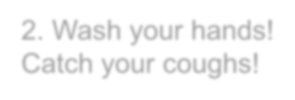



Five key
3
. Clean! Clean! Clean
!
principles
4
.
Reduce mixing
2
. Wash your hands
!
and
maximise
Catch your coughs!
distancing
5
. Engage with
Test and Trace
1.
Stay at home if ill
or a contact
All of these measures help to
prevent the spread of infection
and will therefore protect staff
and children

Slide 14
Principles
People with symptoms = possible case
Isolate- do not come to setting!
Get tested- NHS portal/ 119
People with a positive test = confirmed case
Isolate the case
Contacts isolate for 14 days
Incubation Period =
time between exposure to the virus and developing symptoms
= up to 14 days (most likely shorter)
Infectious period = from 48 hours prior to symptom onset (or date of swab) to 10 days after
Notes:
CONTACTS ISOLATE FOR 14 DAYS – whether they get a negative result or not.
POSSIBLE CASES- GET TESTED- IF TEST NEGATIVE AND THE CASE IS WELL- CAN RETURN TO SCHOOL AND HOUSEHOLD STOP ISOLATING
If case remains unwell and has symptoms of COVID need to assess the case/ situation= ?False negative test

Slide 15



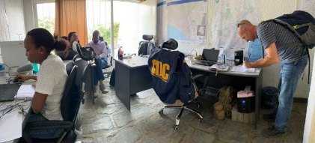
Contacts of contacts DO NOT need to isolate
Father of child confirmed with COVID-19
Whole household has to isolate (including children coming to your setting
People in setting have not had contact with the father
Other close contacts have to isolate
People who have been in contact with contact- do not isolate
Therefore they do NOT need to isolate
Notes:
Images from CDC PHIL

Slide 16
Bubbles a difference between June and Sept.
Bubbles make it much easier for pupils to do what they were doing before, with sensible risk management
In Primary, bubbles are typically a class or year group, in secondary a year group
There shouldn’t be as many constraints, particularly in primary around pupil movement within the bubble and if you/or your child is anxious about this element of return – talk to your child’s class teacher or form tutor
Bubbles should allow for greater safe social interaction between the CYP that are within them

Slide 17
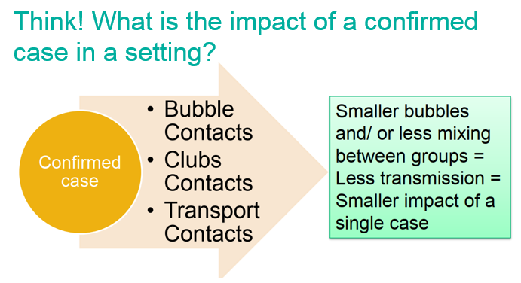
Bubbles

Slide 18
Confirmed cases and local lockdown
The schools will have in place systems and processes if for any reason they will need to partially close or close in the context of a confirmed case or during a local lockdown.
There should be clear guidance from the school and a home learning offer. If a bubble is closed, then the bubble should receive an online learning offer, the same would apply if a school were to close for any reason.
In a school partial or full closure in the Autumn Term, it is more likely that there will be a much clearer timeframe for return that should alleviate some of the anxieties that children and parents/carers will have

Slide 19
School and Parent relationship
Know your bubble: this can really help you and help your child, the school will be able to explain the bubble size and these have been tailored to meet need
Don’t be afraid to ask questions: most schools are very happy to share their risk management measures and processes
If you have been bombarded with information from a school, its probably because they want to provide as much support as possible. There is often mileage in going back and just asking for the key points
Coproduction is important, so if you have an EHCP use the next week to work with the school to look at how this will be delivered in the short and then long term
If you are expecting the full return of your CYP then be really clear to state this, we are supporting phasing in the more exceptional circumstances, but this will not be the norm

Slide 20
School preparations (SEND)
The DfE guidance says: ‘some pupils with SEND will need specific help and preparation for the changes to routine so teachers and SENCos should plan to meet needs, for example using social stories
If your child has SEND, the school SENCo/class teacher should have been in touch during the latter part of the summer term and should be there at the start of the new term to agree a plan of support. Virtual meetings are always possible.
All school must publish details on their websites which will include the details of the SENCo and which should also contain information on how they will involve parents and carers in their child’s education

Slide 21
Your child’s new class teacher needs to know (SEND) – so help them to help you…
What your child is good at and what they enjoy
What helps them listen, focus and learn and the best ways to communicate with them
What helps them to calm down if they get distressed or stressed and any triggers
What they might find difficult in the return to school and what you and your child think will make it better.
It is important to share information with your child’s class teacher and/or tutor as this can be disseminated to other staff.

Slide 22
Children with an EHCP
During the lockdown the Coronavirus Act allowed the Secretary of State to issue a notice, on a month by month basis, to relax the LA and health duty to secure provision in an EHC plan to reasonable endeavours
From the 1st August however, the LA and health need to secure full provision as specified in the EHCP
Until the 25th September, the Coronavirus Act allows for the timescale of reviewing an EHC plan, to be temporarily changed to as soon as reasonably practicable
This can only be applied on an individual case basis and only until the 25th September

Slide 23
Children with an EHCP
The DfE guidance is clear that for a child with an EHC Plan: ‘schools should, in the spirit of coproduction, contact parents and involve them in the planning for their child’s return to the school from the start of the Autumn Term
Settings should also contact and involve young people over 16 who have education, health and care plans
This planning may involve, visits to the settings in advance of the return of all CYP, social stories, remote contact with the class teacher/SENCo, email contact and sharing of resources
There will need to be flexibility – bathroom breaks/use of the outdoors and other measures can be adapted to meet need

Slide 24
Specialist settings
The expectation is that specialists, clinicians, therapists and other support staff to provide support for pupils as usual with SEND
We would expect that before the CYP return that staff are suitably trained and supported, with PPE (where there are very specific medical needs involved)
There may be a phasing in of CYP if agreed with parents and carers in some circumstances and where this is deemed the most appropriate route with the child. The schools will look different, so there may be specific circumstances where a more structured route is appropriate
Home learning/tuition may be possible with appropriate risk assessments in place, check with your provider

Slide 25

DFE View on professionals visiting
“Schools cannot refuse admission to visiting professionals unless of course they have symptoms” (Andre Immich 16/7/2020).
However, we want to respect our local leaders and support them in their endeavours to open their educational settings safely.

Slide 26
How are we supporting school leaders?
All visiting staff to adhere to the individual setting protocols on PPE and working practices
All teams to have their own practices based on the following principles:
Individual agencies and teams need to take responsibility for how visiting staff can ensure our schools are safe places.

Slide 27
South Gloucestershire professionals approach
They will continue to make use of technologies to support face to face meetings where ever possible;
They will work to identify and prioritise the most vulnerable pupils and to focus schools visits on this cohort;
They will limit the number of visits per day and ensure guidance on hygiene routines (such as handwashing) are followed. This will be reviewed regularly;
They will not visit educational settings if we are unwell and quarantine guidance will be followed. We will adhere to any contract tracing procedures;
They will liaise with you before visiting to ensure we follow your processes and procedures;
If we can work with a young person elsewhere (such as a home visit) we will endeavour to do so. We will use risk assessments to keep all safe when we do make home visits.
We will be mindful of individual needs when using PPE and social distancing depending on the varies needs of our children and young people.

Slide 28
Some specific questions
How will children with additional needs be supported in planning their return to school?
All schools must have considered planning for children and young people with additional needs in their recovery plans and risk assessments. They should be based on what they already know about the child’s needs and review their individual plans in light of any impact of Covid-19 with you. If there are things which have increased the vulnerability of a child, this will be considered in the planning for their return, but again should be coproduced.

Slide 29
Some specific questions
My child has ASD. Is there anything I can do to support them with the return to school next week?
They may find change difficult and it is important that you help them to understand which parts of going to school will still be the same and what will be different - predictability and understanding will help your child to re-access school successfully in September. It is important for you to know you can, at anytime, contact your child’s school or educational setting, to talk to someone about your thoughts or concerns and plan with them a child centred approach before your child returns to school. Your child’s school will be able to help you and your child understand the changes – some ideas of how they might do this include: -
Short videos and photos of your child’s new…
o Teacher, support team, new staff
o Classroom, where they will sit, their peg/locker
o Where their resources will be stored (i.e. their drawer)
Responding to specific questions you/your child may have through email
Postcards, letters, a copy of their timetable, etc
Updating their website or posting messages on the school’s communication app (e.g. Dojo or Tapestry)

Slide 30
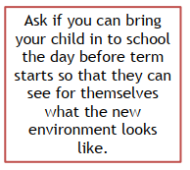
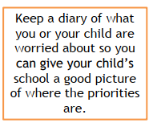
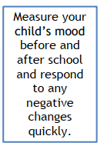
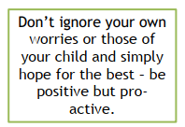
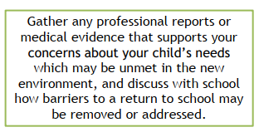
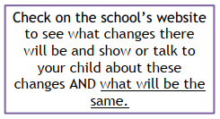
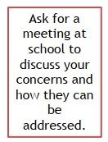
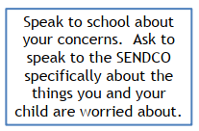
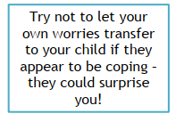
Some general tips

Slide 31
Useful Resources
South Gloucestershire Local Authority is engaging in a Recovery Curriculum approach through our initiative #southglosconnect. All our schools, Primary, Special and Secondary, maintained and academies will be accessing various resources that will be developed: https://www.integra.co.uk/southglosconnect/
Lenny and Lily in Lockdown and Lenny and Lily Return to School will help children make sense of their experiences during the coronavirus pandemic, communicate their feelings and prepare for more change as they go back to the classroom. As the stories are told in pictures alone, it is not necessary for children to be able to read words to enjoy them. This means they are appropriate for pupils in both mainstream and special education settings.
Both stories are structured around the 5 Losses and 5 Levers of the Recovery Curriculum - www.recoverycurriculum.org

Slide 32
Useful Resources
NHS Resources and videos
Handwashing for teachers
Handwashing for children
Coronavirus factsheet for kids
eBug
https://e-bug.eu/
PHE webcasts for all professionals working in educational settings
Breaking the chain of infection

Slide 33

Useful Resources

Slide 34
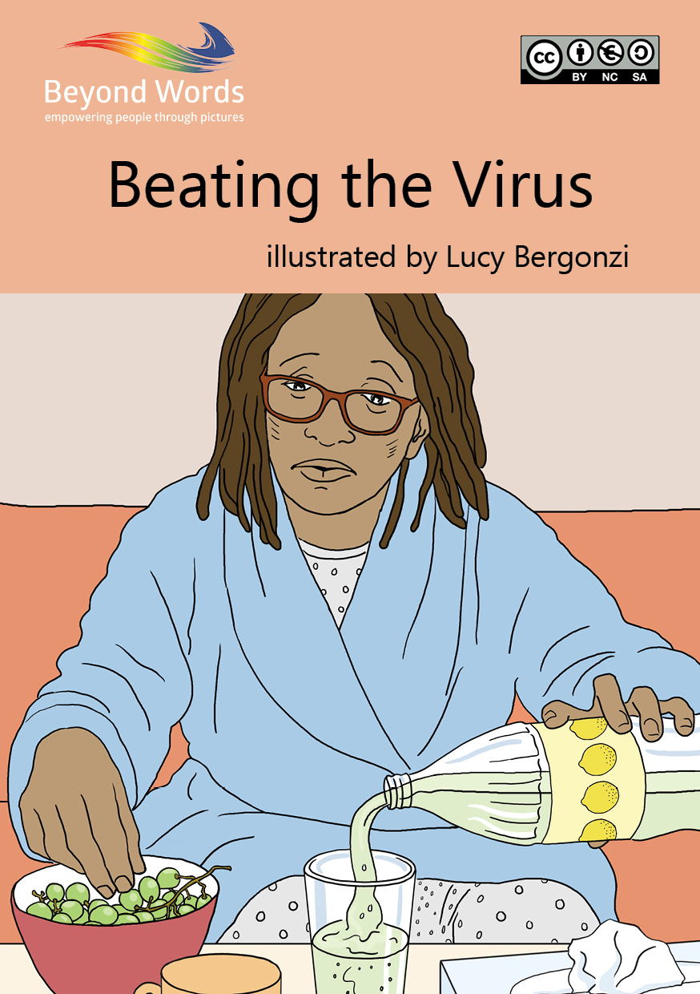
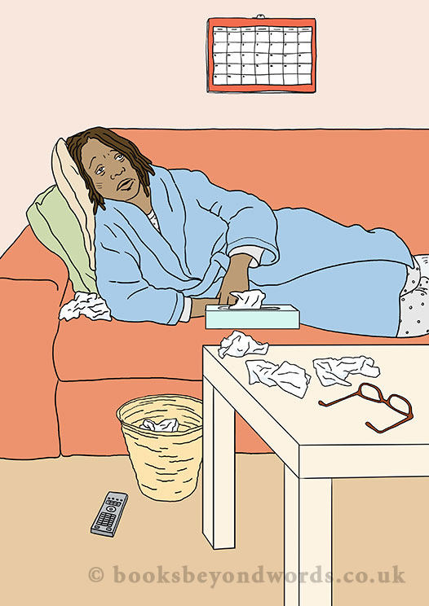
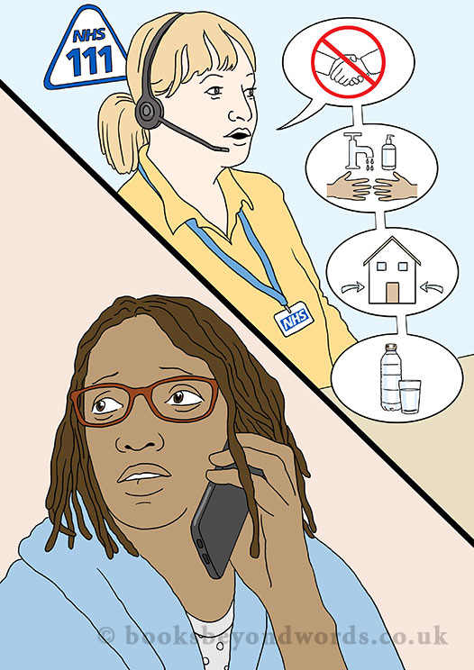
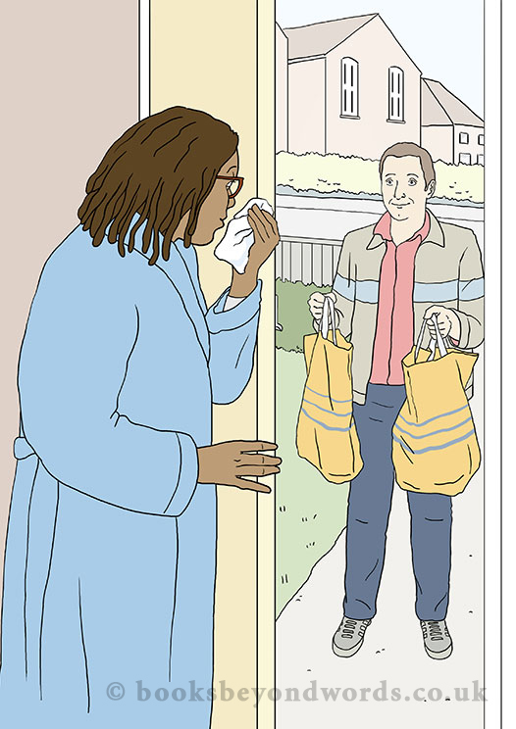
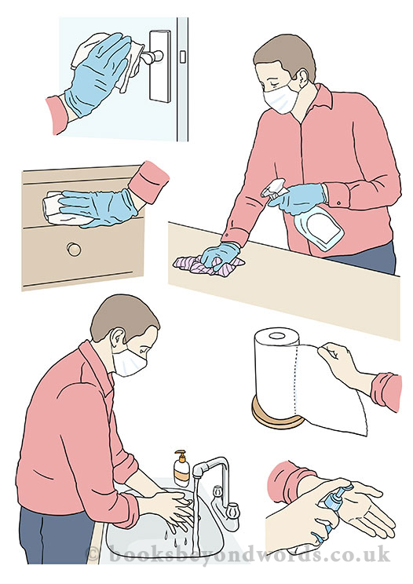
Available for FREE: www.booksbeyondwords.co.uk/coping-with-coronavirus

Slide 35
Parent and carer: our preparation advice
If you think the return will be ok, then this will make it more likely that your child will; calm words and actions will support
Try and create as much consistency and structure; have boundaries for sleep and technology
If your child is anxious about going back, find out why, make a worry list and reward those first steps back
Anxiety is a key block to learning. It can prevent the imprint on the brain; children learn best when things are calm
Keep the ‘how has it gone?’ question low key and calm, give them space but make room to listen
Friendships and relationships are likely to change and this is normal; talk about these shifts as a given and provide opportunities for newly formed ones
Don’t try and fix difficult emotions, come alongside, empathise and when the time is right, problem solve
Become a sounding board, listen…
Talk to the parent and/carer forum and us also us….

Slide 36
Q and A

