Slide 1
#SouthGlosConnect
Reconnecting, resilience and recovery
in our school communities
Primary, secondary and special schools, system leaders and stakeholders partnership project

Slide 2
What is #SouthGlosConnect?
A partnership project to connect school communities post pandemic
Five teams, working to develop resources and information to support schools in their work post pandemic
An online web resource for staff to ‘dip in/out’ of – this will complement any existing school curriculum and systems

Slide 3
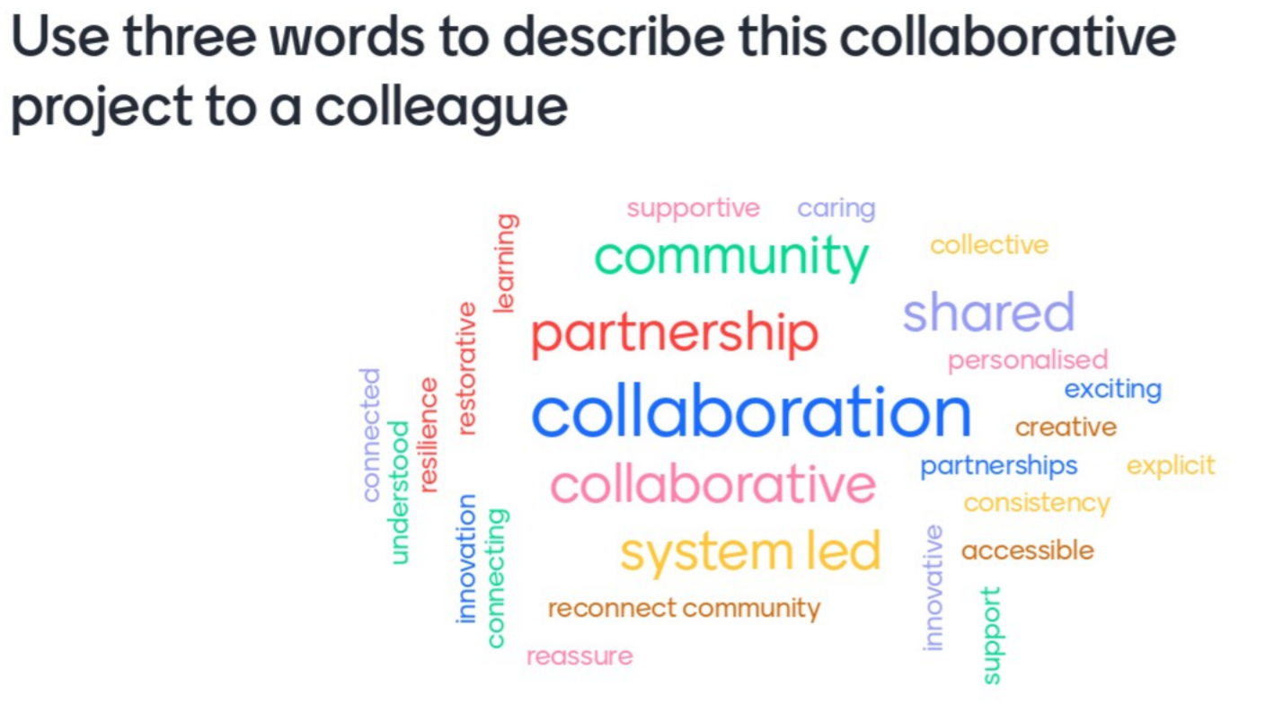

Slide 4
#SouthGlosConnet… Reconnecting, resilience and recovery in our school communities
1. Strategic oversight group
5. Stakeholder group (Parents/carers, governors/trustees, staff/Headteacher well being)
5
2. Stress, trauma,
loss and bereavement (SEMH) group
supported by specialist schools and settings, supported by specialist schools and settings
2
1
4. The reconnection to reparation, recovery to resilience curriculum.
(Rising strong curriculum,
Enduring strong curriculum,
Transitions)
4
3. Valuing the unique learner group (SEND, EAL, PP, GRT, more able, the tutored child)
3
The 5 Cells – Teams from primary, secondary and special… Maintained and Academy
Teams also include parents/carers, governors, council staff and integra staff

Slide 5
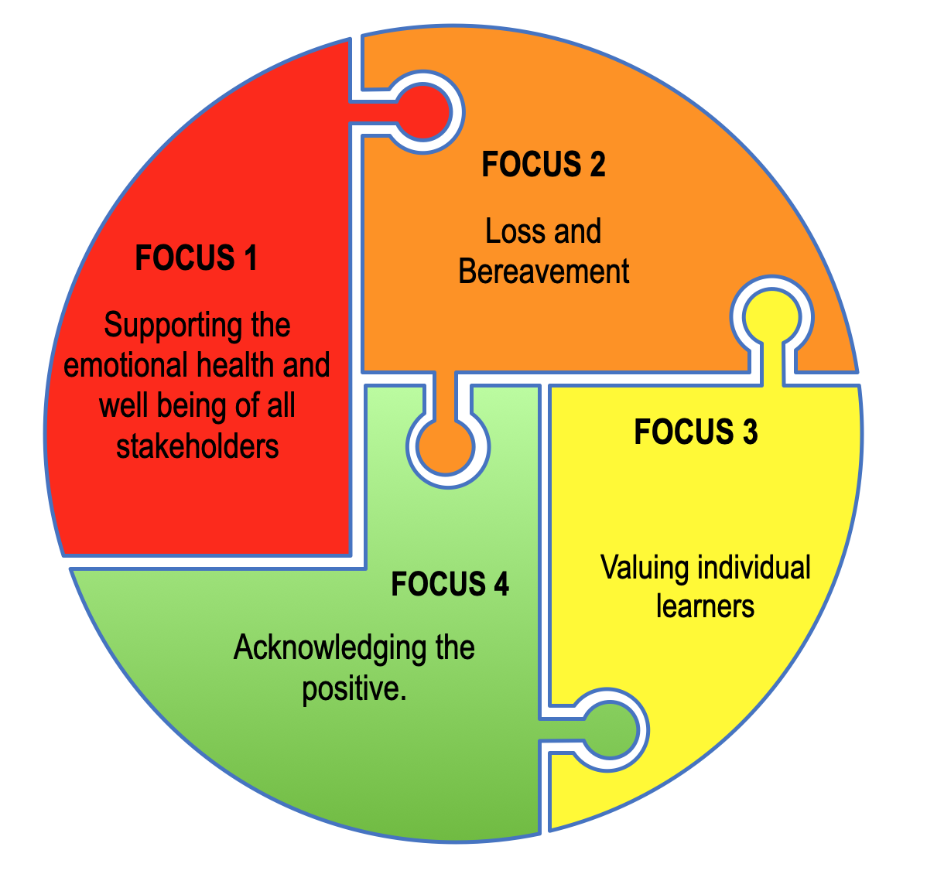
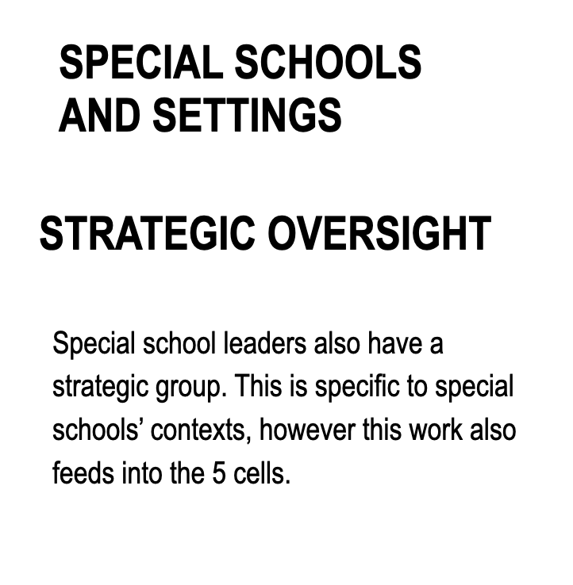

Slide 6
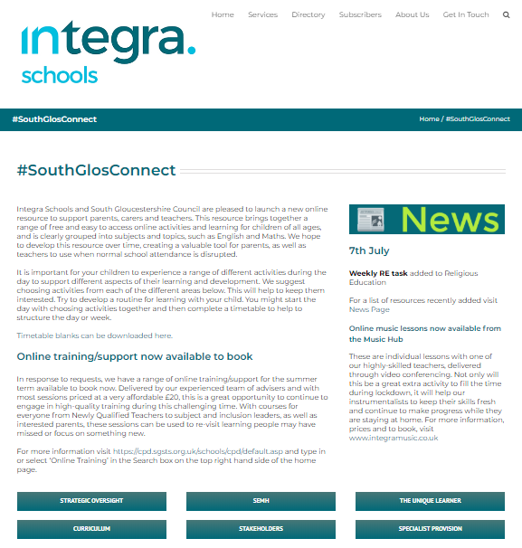
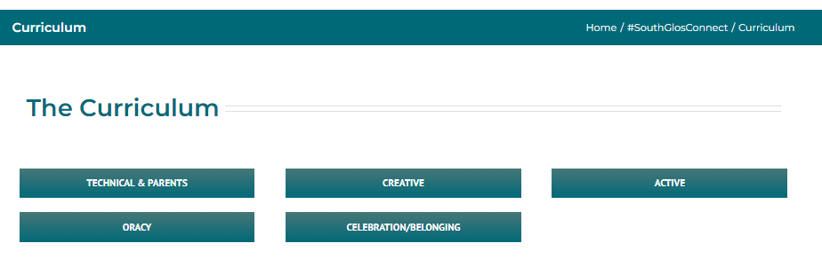
#SouthGlosConnect Website

Slide 7
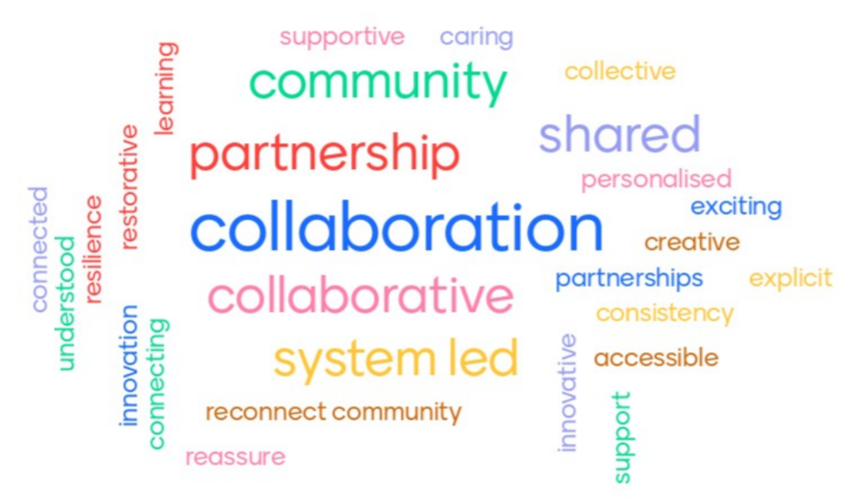
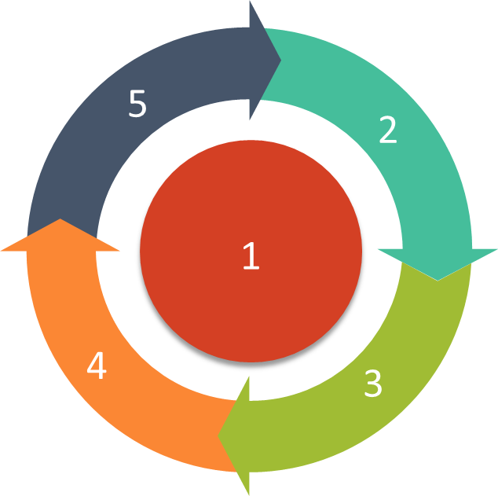
#SouthGlosConnect… Reconnecting, resilience and
recovery in our school communities
Cell 1
Ensuring a flow/synergy between the cells to ensure effective strategic oversight and avoid duplication.
Ensuring all schools know what the purpose and objectives of the project are.
To ensure seamless links between the recovery curriculum and the South Glos Way toolkit.
To ensure resources and publications are uploaded swiftly to the integra website once the cells have developed them (stored on share point).
To gather and analyse impact data/intelligence across the 5 cells.

Slide 8
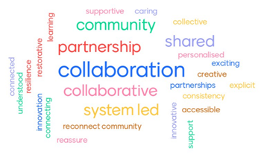
#SouthGlosConnect… Reconnecting, resilience and
recovery in our school communities
Cell 2
To support schools in their development of suitable frameworks required to help them begin to reconnect with CYP and reintegrate them back to school. Specifically in relation to their social and emotional needs.
Provide guidance and signposting for schools, to the networks of support that are available for CYP and families who have experienced traumatic lockdown experiences. eg bereavement / loss / ACEs triggers.
Support schools with training and focused approaches to rebuild resilient staff, develop trauma informed practice and ‘safe’ environments.

Slide 9
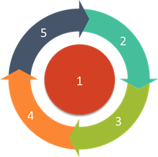
#SouthGlosConnect… Reconnecting, resilience and
recovery in our school communities
Cell 3
Developing a personalised approach for children with EHCPs and those with complex needs in process towards an EHCP.
Developing a personalised approach for disadvantaged children including EAL and GRT.
Developing a personalised approach for high achievers.
Developing a personalised approach for children with autism.
Developing a personalised approach to transitions for children in vulnerable groups.

Slide 10
#SouthGlosConnect… Reconnecting, resilience and
recovery in our school communities
Cell 4
Oracy
Use of high quality text to stimulate pupils’ feelings and articulation of these.
Development of vocabulary across subjects.
Expanding experiences of oracy into wider groups and with improving confidence.
Technology and Parents
To share the resources and experiences – sharing and responding to needs of parents, pupils/students, relationships through the use of technology.
Active learning
Re-engagement with a formal curriculum through active approaches and making link to prior home learning. Transition of learning from concrete, first hand experiences to abstract learning.
Creative learning
Reconnect with their learning and pupils being able to articulate and express their emotions, thoughts and feelings in different ways through variety of mediums.
Celebration and belonging
Shared community experience of this time
Celebrating the achievements of all pupils/students and understanding the varying circumstances of experiences. Reconnection and sense of belonging to their school community and sense of identity.

Slide 11
#SouthGlosConnect… Reconnecting, resilience and
recovery in our school communities
Cell 5
To reassure staff through effective communication of information.
To ensure the effective collation of data relating to student welfare.
To ensure governors are privy to key information and are effectively supported to fulfil their role, responsibility and accountability.
To help reassure parents/carers and children/ young people returning to schools and support the developing dialogue and language around learning.
To make sure Headteachers are supported in their role of leading the full opening of their settings.

Slide 12
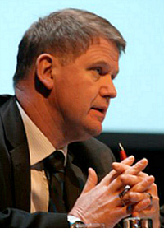
Podcasts
Professor Barry Carpenter
Barry Carpenter was recently appointed to the UK’s first Professorship in Mental Health in Education, at Oxford Brookes University. He is Honorary Professor at universities in the Ireland, Germany and Australia. He has been a Fellow of the University of Oxford.
He has been awarded an OBE and CBE by the Queen for services to children with Special Needs. In 2017 he was entered into “Who’s Who” in acknowledgement of his national and international contribution to the field of Special Education.
Episode 1 Loss and Life for our children and schools post pandemic
https://www.evidenceforlearning.net/recoverycurriculum/
Episode 2 The Recovery Curriculum
https://www.evidenceforlearning.net/2020/05/28/learningshared-episode2-recoverycurriculum-2/?fbclid=IwAR1lwD7QzR_H6Pkfp-csgEVQKhmgLXGFhWMTRlu0eTauku5VVfRd6lQhyOk

Slide 13
The underpinning Levers for our South Gloucestershire Local Authority Approach;
Reconnection to Reparation, Recovery and Resilience
Lever 1 – Relationships
Our students won’t all return joyfully. Relationships that were thriving are going to have to be nurtured and restored. We need to PLAN for this to happen. Reach out to the students and greet them – cushion the discomfort of returning.
Lever 2 – Community
Curriculum will have to be based around the community for a long time. We need to listen to what has happened in this time, understand the needs of our community and engage them in the transitioning of learning back into school.
Lever 3 – Transparent curriculum
Students will feel like they have lost time in learning and we must show them how we are addressing these gaps, consulting and co-constructing with our students to heal this sense of loss.
Lever 4 – Metacognition
In different environments our children will have been learning in different ways. We need to make the skills for learning in a school environment explicit to our students and reskill and rebuild their confidence as learners.
Lever 5 – Space
To be, to rediscover and to find their voice on learning in this issue. It is only natural that we all work at an incredible pace to make sure this group of learners are not disadvantaged against their peers, providing opportunity and exploration alongside the intensity of our expectations.

Slide 14
#SouthGlosConnect… Reconnecting, resilience and
recovery in our school communities
Lever | Examples as to the how | Purpose, the why | Impact and evidence of success
Lever 1 Rebuilding relationships | Greet each morning with a smile, a relaxed body language that shows the child that they matter and that you are genuinely pleased to see them. | This can be achieved through attuned, positive and purposeful over exaggerated interactions, that help our pupils feel that they are important. | Children will be happier to come into school, reduced levels of anxiety enabling them to re-engage with learning.
Lever 2 Re- establishing community | Assess children’s individual needs, allow them to share their experience of lockdown and the pandemic, this may be done through discussion, drawings, stories and other creative mediums that allow for exploration in a safe and supportive way. Acknowledge and validate their feelings | Children will have experienced lockdown very differently to one another, through creating an atmosphere of openness and honesty the children will begin to reconnect with their environments and redevelop their sense of belonging within the school community | Ensuring the pathway of support identifies the child’s needs at an individual level and appropriate provision is put in place.

Slide 15
#SouthGlosConnect… Reconnecting, resilience and
recovery in our school communities
Lever | Examples as to the how | Purpose, the why | Impact and evidence of success
Lever 3 Transparent curriculum | Being open and honest about the way in which the losses have affected us as adults will help children understand the internalising emotions that they too may have been carrying since school closed. Seek to understand what the children already know and help them to find the facts to questions like * why did school close so quickly? * why is school so different now? * when will I see my friends? * why am I allowed to return to school and some of my friends aren’t. Along with all of the questions that children want to share and discuss | Children will have heard a lot about the pandemic in the media and by overhearing discussions within the environment at home/shops etc. and some will be factual whilst others will be someone else’s interpretation of a situation. They may have heard about somebody dying or have had to deal with the death of a close family member/family friend. It is important that as adults we offer the children the real facts and use open and honest dialogue to help them to problem solve. | Children will be confident to share what they know and understand. They will use the relationships that they have with adults to support them.
Lever 4 Metacognition (thinking about thinking) | Children will have been learning in different ways through home schooling, it is essential that we re-teach the way in which we learn at school. We can do this by setting out the routine of the day, encouraging opportunity for thinking, reflecting and evaluating. Children will respond to a thematic approach where they can become fully immersed in a topic of interest that can be explored through each subject and using both the indoor and outdoor environment, learning becomes embedded when we use the whole body. | It is vital that children learn to love learning once again and can begin to recall the passion that was instilled in them before the lockdown. Children will naturally feel safe and secure within a classroom environment, if they | Children will be curious, inquisitive, they will ask questions that require higher order thinking. They will have FUN and will demonstrate an eagerness to keep going.

Slide 16
#SouthGlosConnect… Reconnecting, resilience and
recovery in our school communities
Lever | Examples as to the how | Purpose, the why | Impact and evidence of success
Lever 5 Space Time and space to rediscover self and to find their voice | Ensure children are provided with time and space to readjust to the new classroom layout, adult they are working with and changes that have been made. Carefully explain and offer reasons for the change. Explore a whole bubble agreement and share stories of being in a bubble and what that means Ensure time is planned in for movement breaks and sensory circuits | Children will need time and space to readjust and to begin to trust in the safety, stability and security of the classroom environments. As adults we can support our children by firstly regulating, acknowledging and validating feelings and emotions which will the support us in beginning to re- establishing safe and trusting relationships | Children who are settled to learn within their classroom environment and confident to share thoughts, feeling and ideas freely.

Slide 17
#SouthGlosConnect… Reconnecting, resilience and
recovery in our school communities
Reflections:
What have we learned in recent times and how can we use this as a positive?
How can we be agile and capitalise on this as an opportunity?
How can we harness parents support and be more explicit about learning?
How can we ensure that our schools/trusts are central to their community and build on the positives seen?
How do we build resilience, self-regulation and promote independence?

